Slide 1
Remember
Sign in:
https://sites.google.com/view/dotslashscript/sign-in
NEEDED:
https://seedsecuritylabs.org/lab_env.html
https://www.virtualbox.org/wiki/Downloads

Slide 2
Buffer Overflow Attacks
Exploiting Memory Vulnerabilities

Slide 3
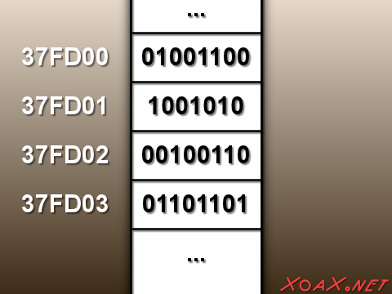
Intro
Volatile vs Non-Volatile Memory
x86 Assembly Language.
Notes:
Volatile Mem : RAM
Non Volatile : virtually everything else

Slide 4
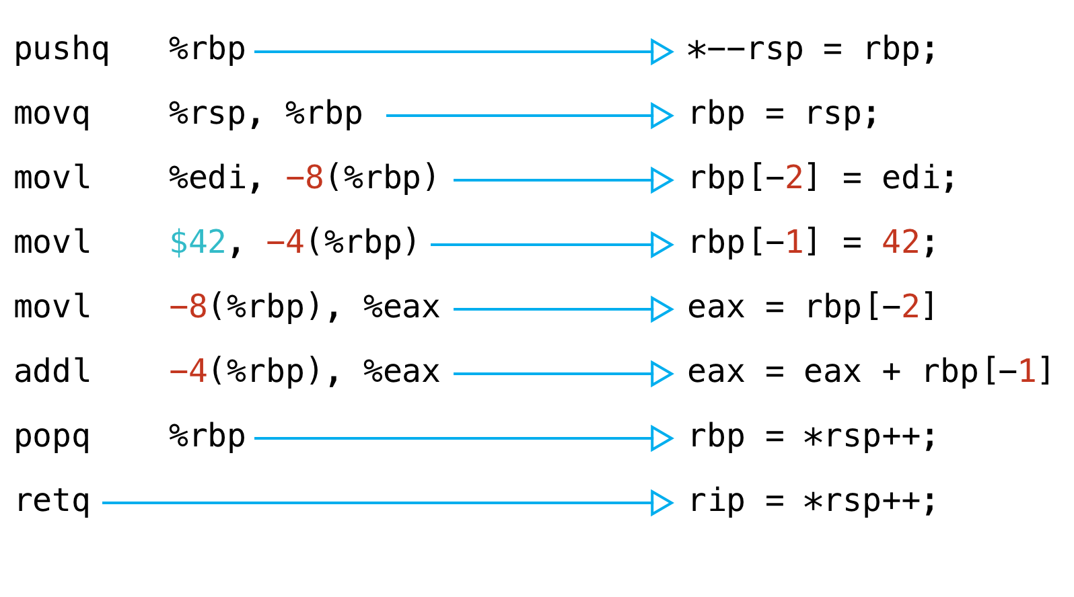
X86 example
Notes:
X86 example

Slide 5
Memory Corruption
Modifying a process’s memory in an unintended way.
A broad term that encompasses a large portion of what makes up modern exploitation.
The vast majority of system-level exploits involve memory corruption

Slide 6
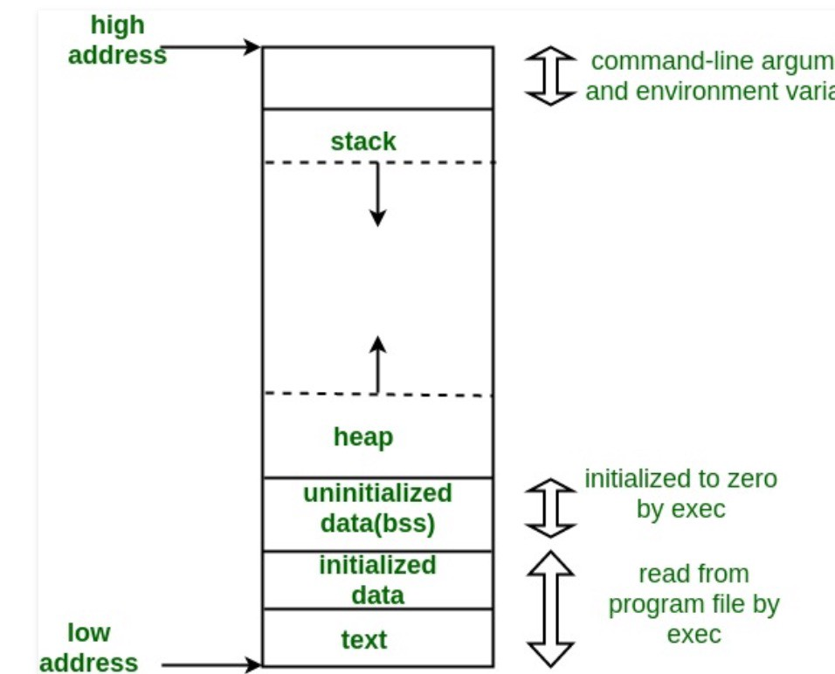
Parts of a Program in Memory
Stack adds and remove variables as needed
Ex: int x= 14;
Return x;
Heap comprises a large pool of memory to allocate variables
Int *age = malloc(sizeof(int)))
*age = 30;
BSS section holds uninitialized static variables
Text section holds executable instructions
Notes:
Data section vs Instruction section example

Slide 7
Important Registers in x86
EBP | Holds pointer to base of stack frame
ESP | Holds pointer to top of stack
EIP | Holds pointer to next instruction

Slide 8
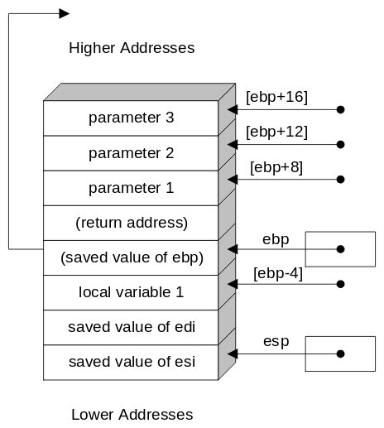
The x86 Calling Convention
Functions ran on x86 architecture tend to conform to a convention
Not mandatory
Addresses grow from higher to lower
Two words of saved control data get saved underneath the saved base pointer
Canary values get placed between the local variables and control variables

Slide 9


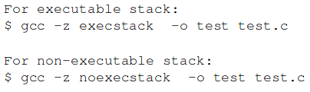
Disabling Defenses

Slide 10
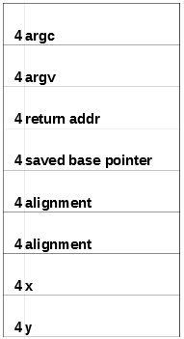
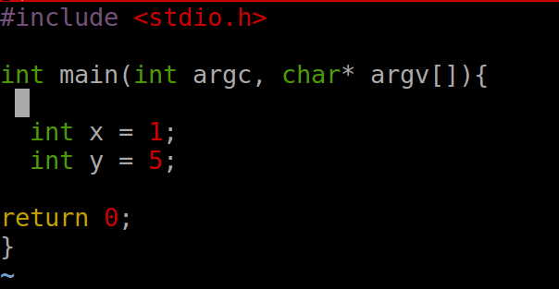
Building a Stack

Slide 11
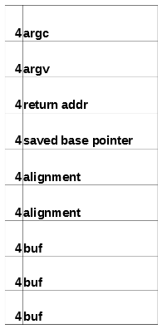
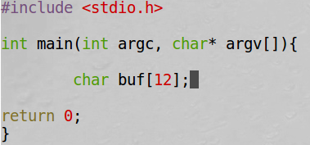
Buffers and the Stack

Slide 12
Challenge
You were given an executable named auth with the goal of authenticating to the program. Along with the executable you were given the source code. Devise a way of authenticating to the program.
Hint: No legitimate method of authenticating to the program exists
Bonus: Craft an input that exploits the vulnerability in the program but still denies you access

Slide 13
The GNU Debugger (GDB)
gdb <program>
break <function name>
break *<instruction address>
run <arguments>
info locals

Slide 14
Activity: Smash the Stack with Impunity!
Attempt to view the results of an overflown stack in GDB
Load the program into GDB
Issue the command: run <long input>
View the results of the segmentation fault in the debugger

Slide 15
Data vs Instructions
Computers have no way of telling if data represents an instruction or simply data
Instructions get separated from data by two mechanisms
Expectation
Operation Codes (Op Codes)
X86 architecture specifies the legal Op codes
If a computer expects an instruction and the data has a legal Op code then the computer will attempt to run the data as an instruction

Slide 16
Instructions in the Data Section
Basic compilation assumes that only data exists in the data section of program memory
Instructions traditionally go in the text section of program memory
Nothing prevents programmers from placing instructions in the data section of memory
If the instruction pointer points to a data section of memory the computer will attempt to run that data as an instruction

Slide 17
Smashing the Stack
Stack smashing refers to overflowing a buffer such that the data placed in the buffer overwrites the control flow variables of the program
Return address
Saved base pointer
When the program returns, the program will attempt to return to whatever “address” got placed in the return address portion
If this happens by mistake the memory address will likely not fall within legal memory for the program to use
Segmentation fault

Slide 18
Returning to Legal Memory
If a return address falls within legal program memory then a segmentation fault will not occur
The central processing unit (CPU) will attempt to continue running instructions from the address the program returned to
The possibility exists to craft input that overwrites the return address with a legal address within program memory

Slide 19
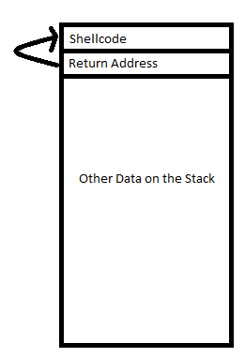
What would happen if we set a return address to return to a section of data memory containing a malicious instruction?

Slide 20
Activity: Compile and Run Shellcode
Obtaining a “shell” gives an attacker the ability to execute arbitrary code on a compromised system
Obtaining a shell with escalated privileges allows an attacker to execute that code as a privileged user
Gaining access to a root shell represents the holy grail of malicious attacks against a system
Notes:
1 Compile and run shellcode
Note the $
Whoami
2 Run shellcode with sudo
Note the #
Whoami

Slide 21
The Stack Smashing Challenge
We want the program to return to a legal instruction
Attackers might have trouble figuring out where a malicious instruction will appear on the stack
If the attacker misses the instruction by a single byte, the attack will fail

Slide 22
The No Operation (NOP) Instruction
Computers require instructions to happen at specific time
A “do nothing”, NOP, instruction assists the machine with timing
The NOP instruction skips a CPU cycle
https://en.wikipedia.org/wiki/X86_instruction_listings

Slide 23
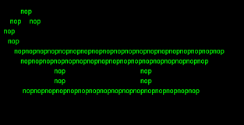
All aboard the NOP sled!
Place an arbitrary amount of NOP instructions directly after a return address
Place the shellcode at the end of the NOP sled
Launch that return pointer to an address you think lies near the return address
PROFIT!

Slide 24
Shellcode
NOP NOP NOP NOP NOP NOP NOP NOP NOP NOP NOP NOP NOP NOP NOP NOP -->

Slide 25
Activity: The Electric NOP Slide
Exploit the program stack in the nop_sled directory
The program exploit.c generates a malicious file
We must craft input such that we return to a NOP slide and execute our shellcode
Start by determining where the return address lies on the stack

Slide 26
Defenses
Address space location randomization (ASLR)
Randomizing where sections of a program get loaded into memory
Makes it more difficult to return to known sections of memory
Stack Canaries
Also known as a stack guard
A random value placed after a buffer or before control memory such as a return address
Operating system checks this value before attempting to return from a function
Data Execution Prevention (DEP)
Marks data sections of memory as non-executable
Prevents instructions from being placed in and ran from sections of memory used to store data

Slide 27
Data Execution Prevention (DEP)
Data execution buffer overflows have existed since the 1980s
Most compilers disable execution of data memory by default
All data segments of memory get marked with a bit that instructs the operating system to only accept data from that location

Slide 28
C Libraries and Include Statements
Preprocessors load entire libraries into source before compilation
Example
#include <stdio.h> loads the contents of stdio.h into the program before compilation
This gives the programmer access to the printf function as well as other input/output functions

Slide 29
The C Standard Library
Many system call function exist in the C standard library
system()
exit()
The system() function calls other processes on the system
“/bin/sh”
The exit() function exits the program
A program that includes the C standard library will have access to these functions
These functions have a constant address in memory
These functions have a constant offset from the start_main() function

Slide 30
Returning to Libc
Literally returning to a function in the C standard library
system() allows the attacker to execute another process
The system() function takes a filepath argument to an executable
system(“\bin\sh”)
If an attacker overwrites the return address with the address of the system() call then the program will execute the system function
If an attacker provides a string, which he/she places anywhere legally accessible on the system, then the system() function will attempt to run that string as if it was the path to an executable

Slide 31
Activity: Return to Libc Attack
In the ret_libc folder you will find retlib.c and exploit.c
You must craft malicious input to force retlib to return to the system() function
Create an environment variable named MYSHELL and set it equal to /bin/bash
Run getenv MYSHELL retlib to find out the address of your environment variable
Use GDB and the p <function> option to obtain the addresses of system() and exit()
Insert them into the exploit.c file, compile and run
Run retlib

